Slide 1
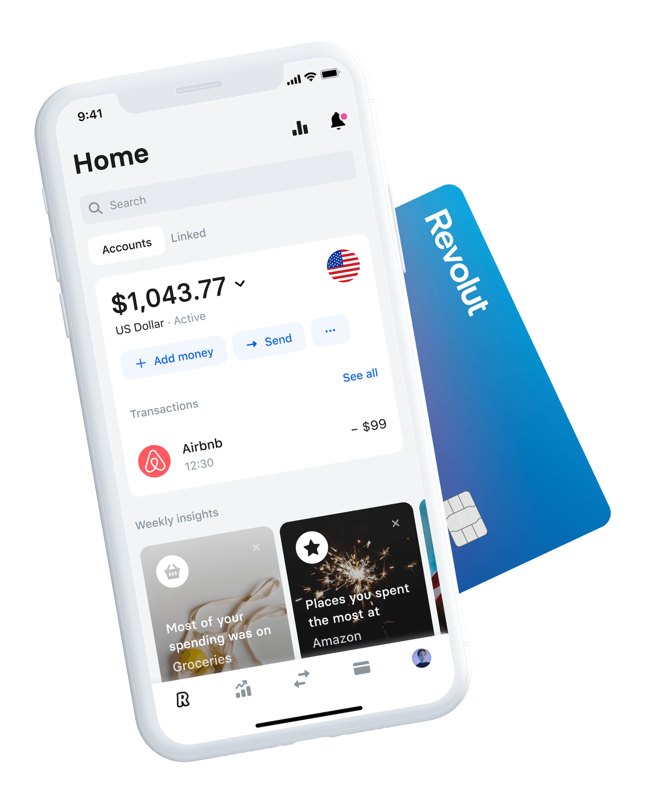
How two start-ups took differently path to Retail Banking and what we have learnt

Slide 2
Re
Key highlights from Annual Reports. There is a big performance difference between Monzo and Revolut, with Revolut pulling away quite significantly, £100m in revenue difference, higher revenue per customer and three times more number of customers, which benefits from economies of scale. In the positive side Monzo's revenues are rising faster than costs.
+180%
£24
+234%
Annual revenue per customer
£20

Slide 3
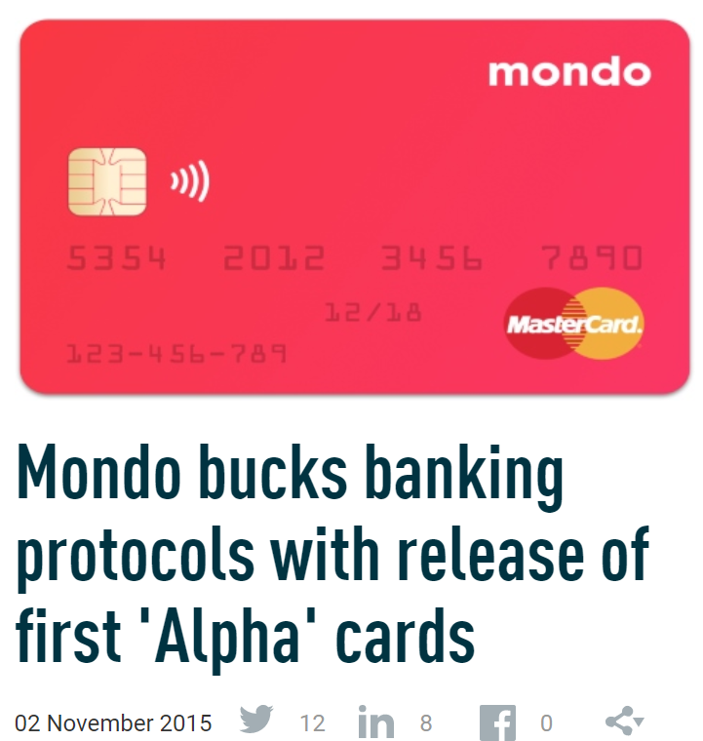
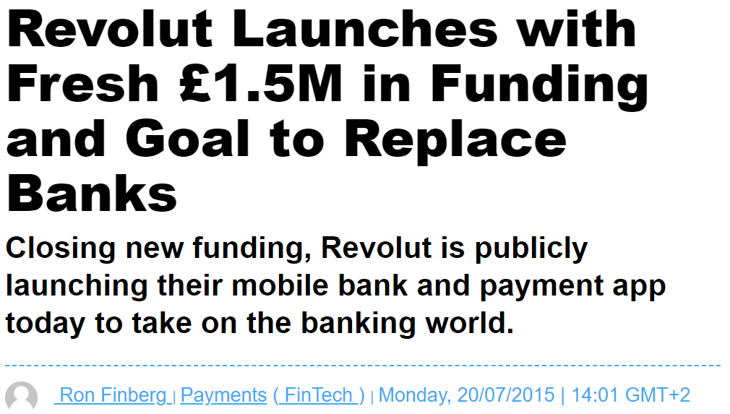
Both challengers launched in 2015, following dissatisfaction from consumers with British banks, whose customer experiences were poor and expensive. They followed different strategies, reached diverse results and so, now facing very different future

Slide 4
Since launch they focus sources on bringing customers on board quickly; however, Monzo in 2017, after getting banking license, concentrated into transitioning customers onto their new current accounts and discontinued the prepaid card. Meanwhile Revolut kept adding innovative products, expanding internationally and bringing on board new customers
1
Strategy focused on getting a rapid e-money license
1
Launched a prepaid card to get customers rapidly onto its platform, while applying for UK banking license
2
Targeted currency exchange rather than current accounts
2
Obtained a full bank charter, to widen the services to offer to consumers
3
Leveraged the EEA passport to expand across Europe and partnered with other FinTechs to iterate quickly
3
Focused on transitioning existing customers onto Monzo’s own current accounts
4
Cryptocurrency exchange platform a viral product
4
Discontinued prepaid card in the UK and focused on adding new banking features. I.e. FX transfers and loans

Slide 5
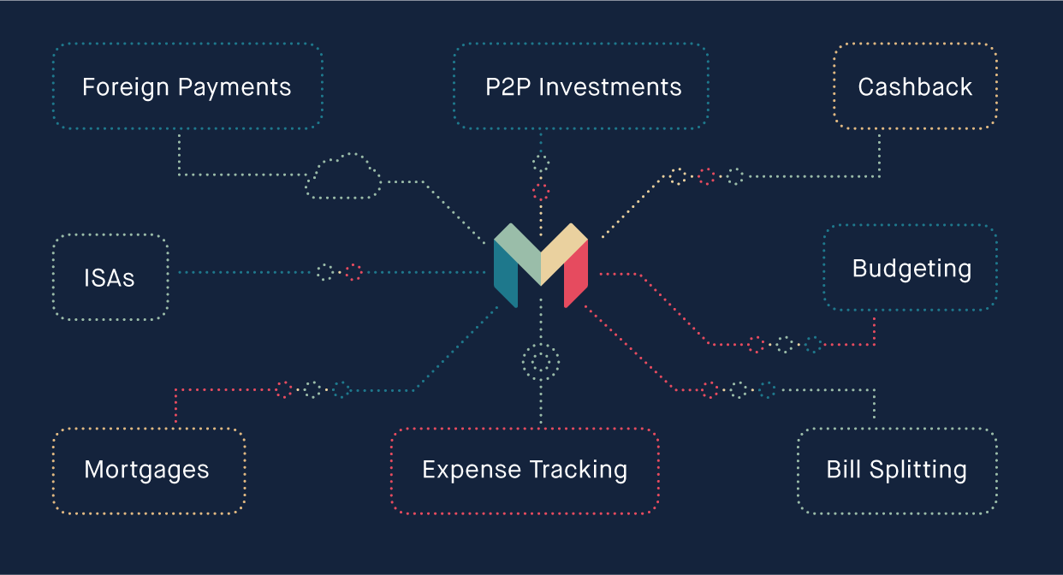
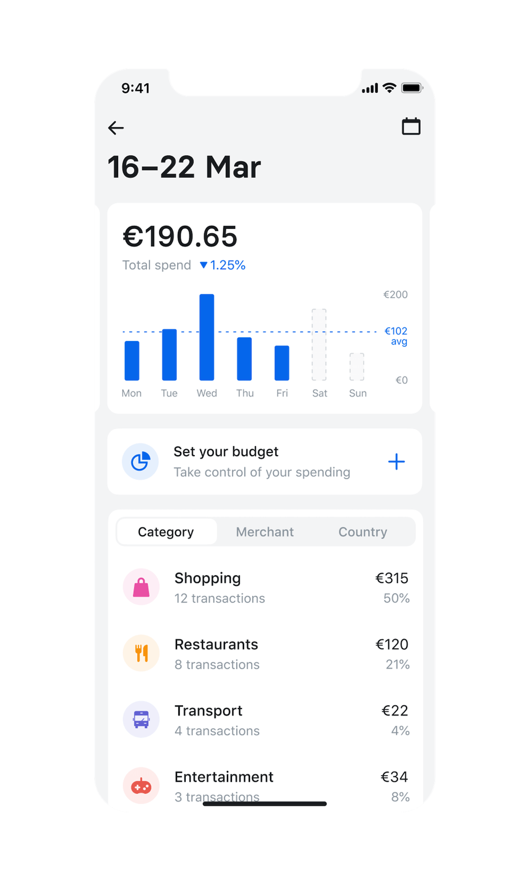
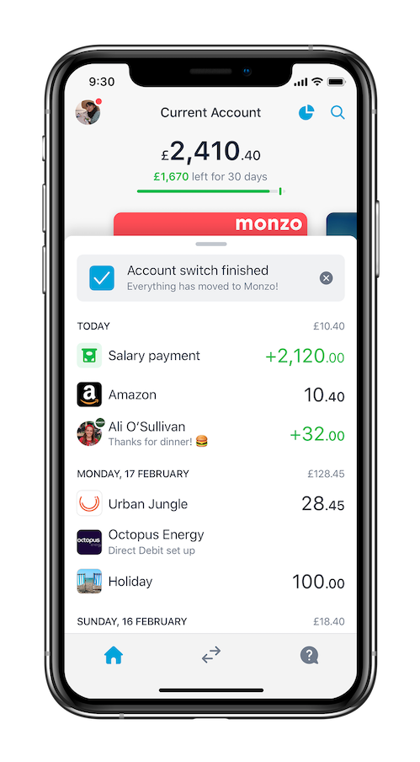
Partnering with other FinTechs led to quick add new services and helped them drive down costs and accelerate grow.
A selection of sartners
“The bank of the future will be a marketplace”

Slide 6
Revolut was designed with travellers and international business people in mind. It rapidly evolved its value proposition and now offers the latest in online banking services including instant payments, currency exchange, lending and even crypto exchange – all via their app. Revolut’s ability to pull in paid users via its subscription service shows it users see value in their proposition.
Product / Service
Current Account
International Transfers
Credit Card |  | -
Saving Account
Investments |  | -
Personal loans | -
Residential Mortgages | - | -
Business Loans |  | -
Insurance |  | -
Free Current Account
Premium Account
Source: Fincog.

Slide 7
Innovative products and new markets has being an accelerator of growth for Revolut. Monzo impacted customers growth in 2017 when discontinuing its prepaid card in the UK. It gained users traction once again through paid marketing and tv ad campaigns in 2018
Revolut achieved 1m customers after two years of operation without a banking license. It took the web-based retail bank of HSBC, 20 years to get the same number of customers.
$5.5B Valuation
(2020)
Dec. 2018 Got European Banking license
Customer growth after Launch
Jan 2018. Crypto Currency launch
$1.2B Valuation
(2020)
April 2017. Got UK Banking License and discontinued prepaid cards
2018 Paid marketing, and TV ad campaigns
Dec. 2019 Monzo attracts the most current account switchers for the first time
Users, millions
Source: Startups newsroom. As August 2020

Slide 8
Higher average deposit and number of customers have helped Revolut to generate bigger revenues than other UK challenger banks. Revolut’s has pulled in paid users via its subscription service. Differently, Monzo is hopping to close the gap by doing more lending and just recently introduced paid accounts
First 5 years growth after Launch
Note: Number of Customers (millions), Net Revenues and Pre-tax profits (£ millions)
Source: Companies annual reports, FT, Dealroom and Craft . As Oct 2019

Slide 9
Certainly a diverse future is expecting for both challengers in the current challenging environment
“Our continued growth and expansion during the pandemic has shown the resilience of our strategic plans and we are pleased that these plans are further endorsed by new investors.”
Martin Gilbert. Chairman at Revolut refering to Revolut 2019 results
“We have assessed the Bank’s ability to continue as a going concern over the year horizon.”
Monzo Annual Report 2020

Slide 10
Final Remarks
The fastest-growing challenger banks in Europe— Revolut and Monzo acquired 1.5M customers through viral growth strategies and without the need of a bank charter.
Revolut challenged the conventional go-to market strategy by applying for an easier-to-acquire e-money license and targeting currency exchange rather than current accounts. Revolut initially focused on frequent travelers, a niche they was underserved and, just then broadened its banking offering.
Lending seems to be the most obvious opportunity for challenger banks to monetise, but it has challenges during the current environment. Strong knowledge of how to effectively lend money and run a healthy loan book are key for success!

